Slide 1
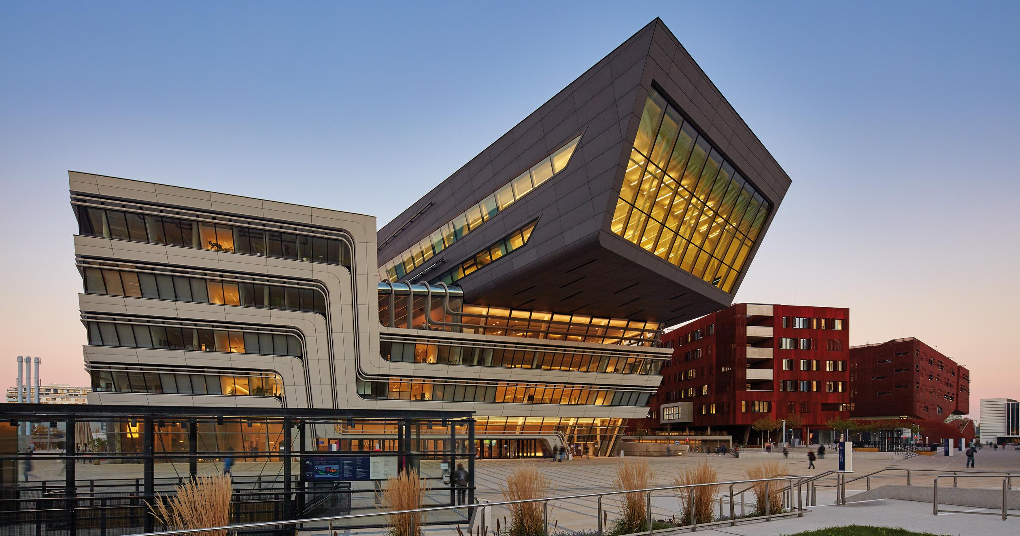
Licenses and e-resources in the consortial environment
Yoel Kortick | Senior Librarian
https://www.wien.info/en/sightseeing/architecture-design/wu-campus

Slide 2
Preliminary note
This presentation focuses primarily on developments from November 2017 onwards which relate to Licenses and e-resources in the consortial environment.
It assumes as a prerequisite a general knowledge of “Centrally Managed Licenses for Electronic Resources in a Network Zone” as described in the On Line Help at https://knowledge.exlibrisgroup.com/Alma/Product_Documentation/Alma_Online_Help_(English)/Managing_Multiple_Institutions_Using_a_Network_Zone/06_Acquisitions_in_Consortia/01_Central_License_Negotiation

Slide 3
Preliminary note
In some cases existing functionality is repeated here within the context of the new functionality.
This is done in order to make the explanations of the new functionality relevant.
Each section here builds on previous sections, and is best viewed in it’s entirety in the order presented here.

Slide 4
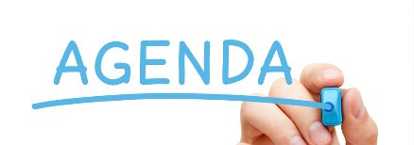









Multiple contacts per member and adding administrators
Navigate from License to Licensor and Licensing agent
Distributing the negotiated license
Creating an amendment to the shared license
Linking member institution resource to network license or amendment
License Negotiation when content differs between members
License multi year negotiation - price per year
http://asm.easternhealth.sg/2014/images/banner-agenda.jpg

Slide 5
Multiple contacts per member
Each member that is added to a license is a member institution of a network.
In this sense, the feature of adding members to a license in the negotiation details tab is relevant only to network installations.
URM-60373

Slide 6
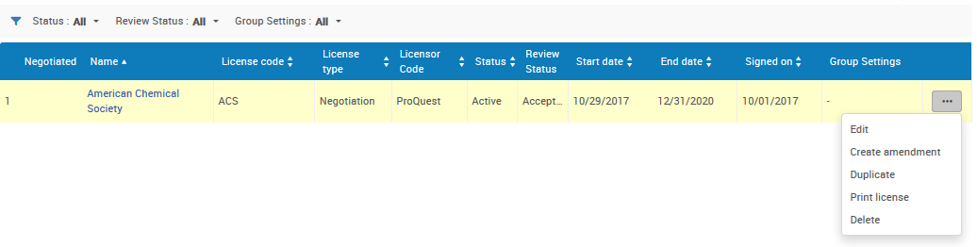
Multiple contacts per member
From the network institution first we will edit the license.
Then we will go to the ‘Negotiation details’ tab
License type is “Negotiation”
We will edit the license

Slide 7
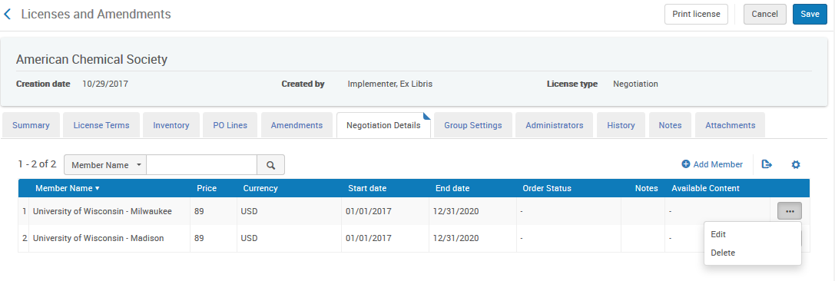
Multiple contacts per member
It is possible to establish more than one contact email for each member.
Members are added from the ‘Negotiation Details’ tab
We are in the ‘Negotiation Details’ tab
We will now edit the first member
URM-60373

Slide 8
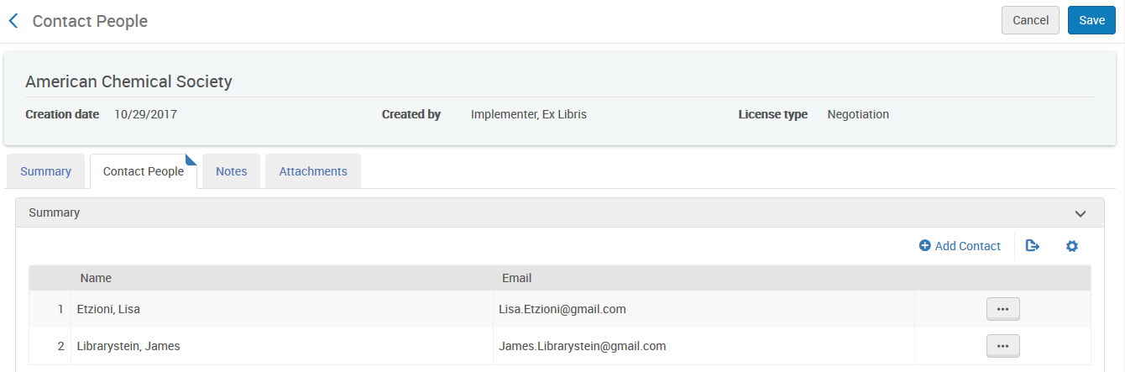
Multiple contacts per member
Within each member multiple contacts can be added:

Slide 9
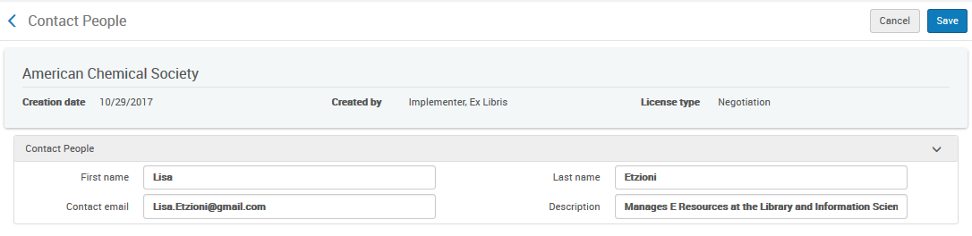
Multiple contacts per member
Here is the first contact

Slide 10
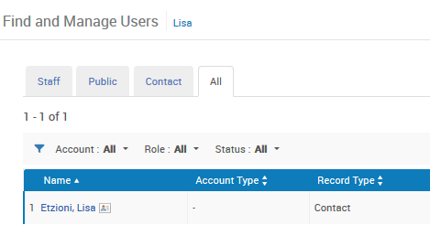
Multiple contacts per member
Each contact gets added to Alma as a user (similar to the same process as when a contact gets added as a vendor)
Here we can see that when Lisa Etzioni was added as a contact for the first member of the license she was also added as a user with record type ‘Contact’ in Alma.

Slide 11
Adding Administrators to the License
It is also possible to add administrators to the license.
The administrators are chosen from the list of users already in Alma.
This differs from the “contacts” we already saw, which are added ‘on the fly’ and subsequently become users in Alma.
The administrators are added per license
The contacts are added per member of the license.

Slide 12
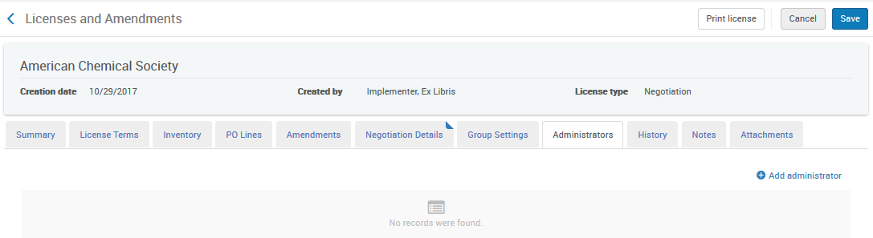
Adding Administrators to the License
From the ‘Administrator’ tab we will click ‘Add Administrator’

Slide 13
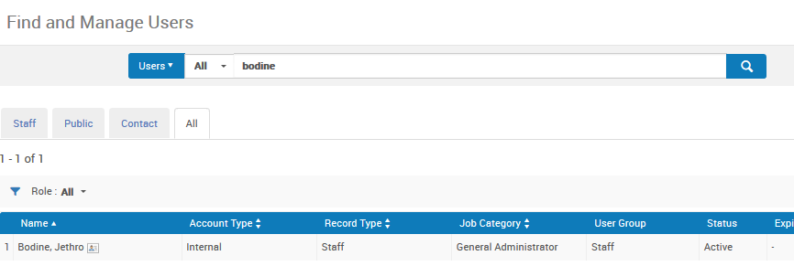
Adding Administrators to the License
We can then search existing users, find a user, click him, and he gets added

Slide 14
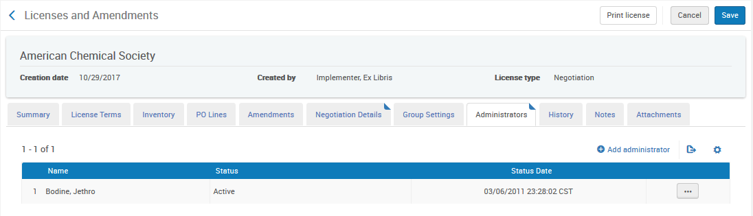
Adding Administrators to the License
He has been added as an administrator

Slide 15
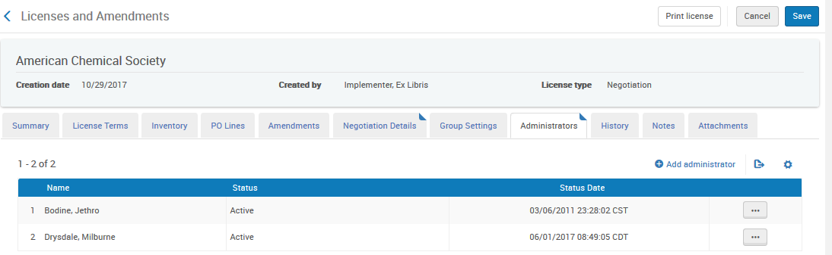
Adding Administrators to the License
And now another administrator has been added

Slide 16
Multiple contacts per member and adding administrators
Navigate from License to Licensor and Licensing agent
Distributing the negotiated license
Creating an amendment to the shared license
Linking member institution resource to network license or amendment
License Negotiation when content differs between members
License multi year negotiation - price per year

Slide 17
Navigate from License Summary to Licensor
From the summary tab of the license it is possible to navigate directly to both the “Licensor” as well as to “Licensing agent”
After linking to the “Licensor” or “Licensing agent” and viewing relevant details the user can click “back” and return to the license.

Slide 18
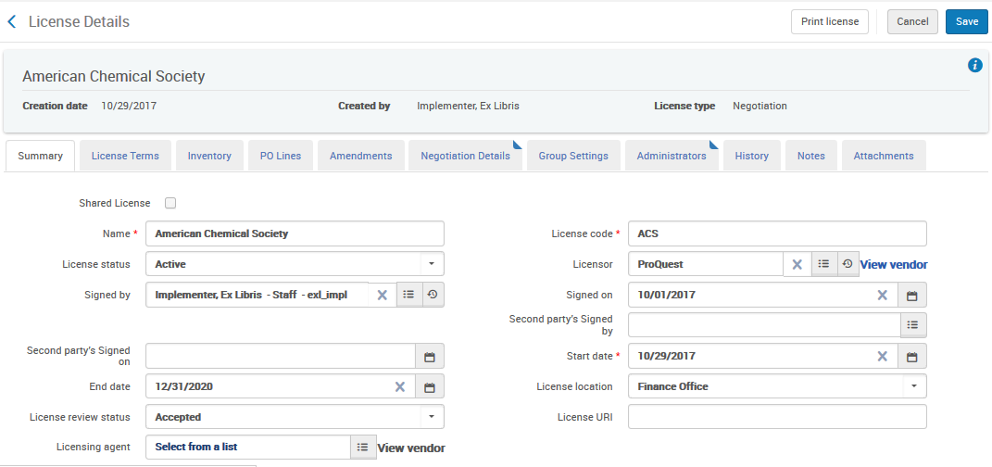
Navigate from License Summary to Licensor
Here the “Licensor” of license ‘American Chemical Society’ is ‘ProQuest’

Slide 19
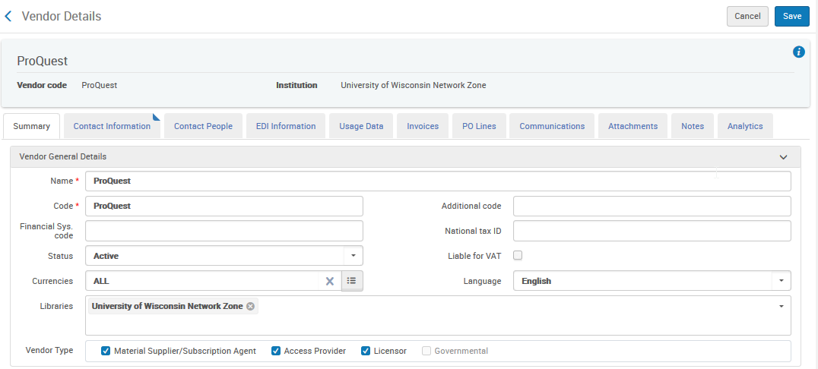
Navigate from License Summary to Licensor
Note that the ‘Licensor’ is a vendor in Alma and is designated as type ‘Licensor’

Slide 20
Navigate from License Summary to Licensor
From the Summary tab of the License we can click ‘View Vendor’ and view this vendor who is of type ‘Licensor’

Slide 21
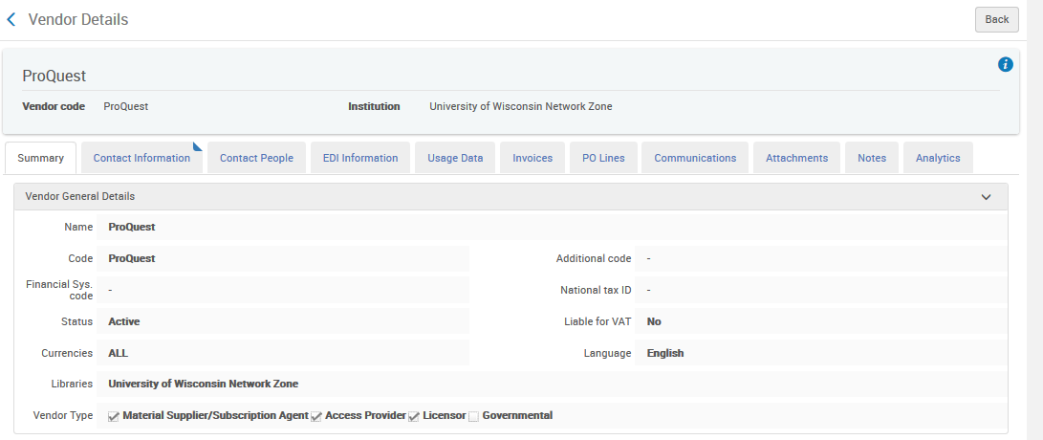
Navigate from License Summary to Licensor
After we have clicked ‘View Vendor’ we are brought directly to the licensor vendor
“Back” returns the user to the license

Slide 22
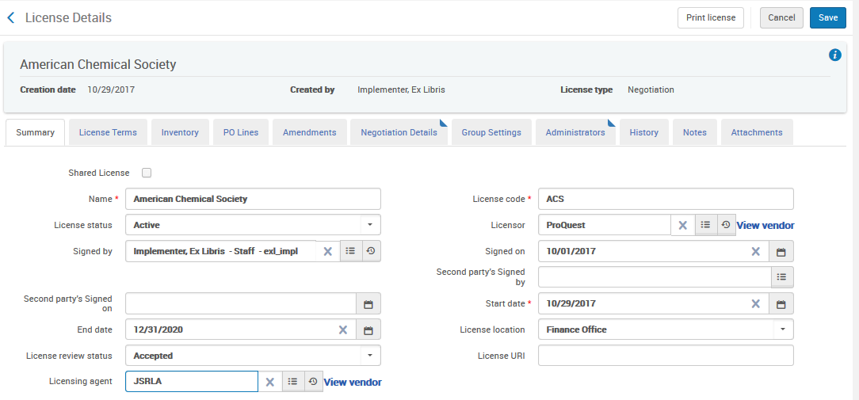
Navigate from License Summary to Licensing agent
Here we have added licensing agent “Jimmy Smith Resources Licensing Agent” (code JSRLA) to the negotiated license

Slide 23
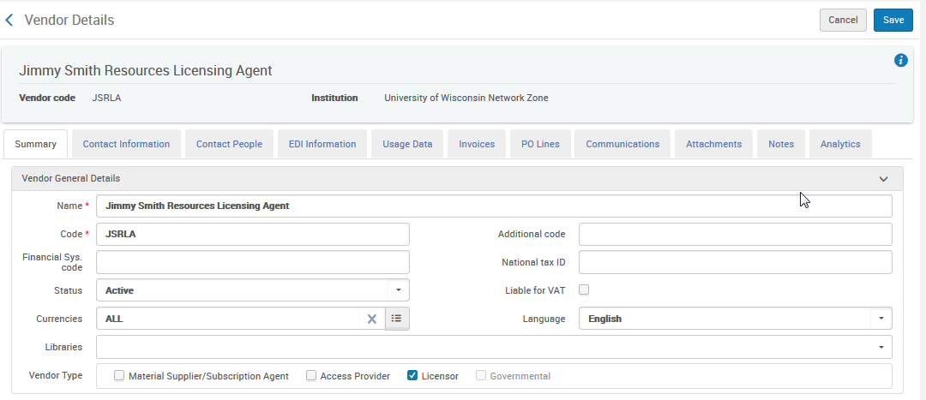
Navigate from License Summary to Licensing agent
Note that like the ‘Licensor’ which we previously saw, the Licensing Agent is a vendor in Alma and is designated as type ‘Licensor’

Slide 24
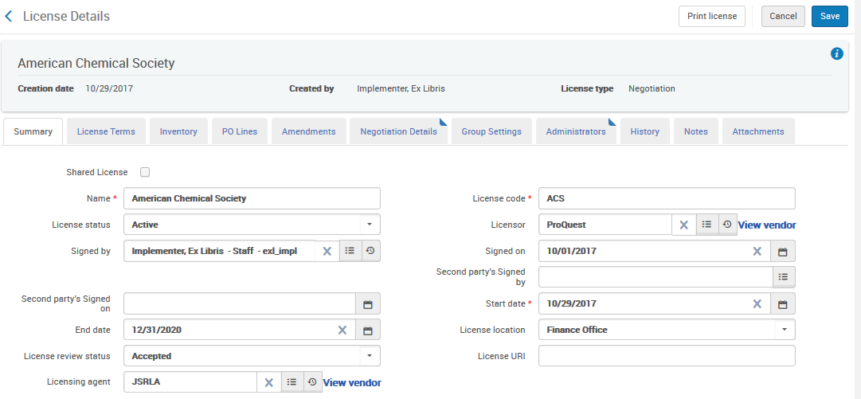
Navigate from License Summary to Licensing agent
From the Summary tab of the License we can click ‘View Vendor’ and view this Licensing Agent vendor who is of type ‘Licensor’

Slide 25
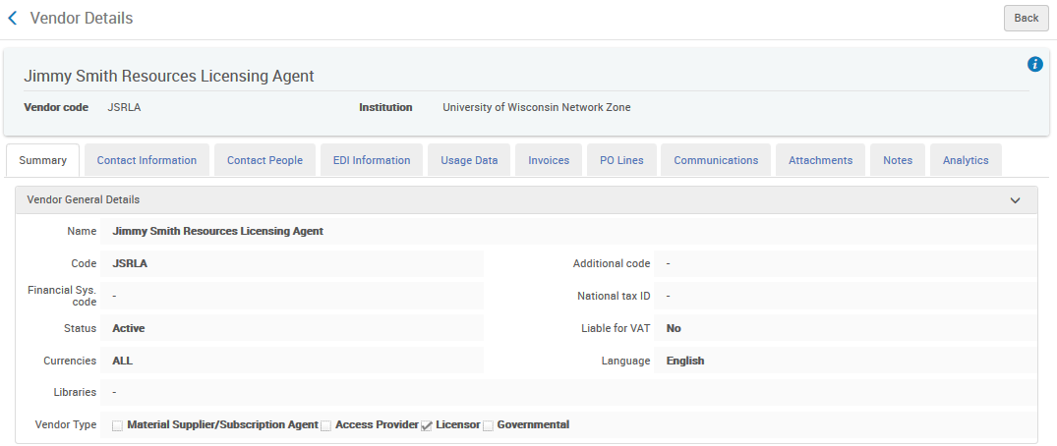
Navigate from License Summary to Licensing agent
After we have clicked ‘View Vendor’ we are brought directly to the licensing agent
“Back” returns the user to the license

Slide 26
Multiple contacts per member and adding administrators
Navigate from License to Licensor and Licensing agent
Distributing the negotiated license
Creating an amendment to the shared license
Linking member institution resource to network license or amendment
License Negotiation when content differs between members
License multi year negotiation - price per year

Slide 27
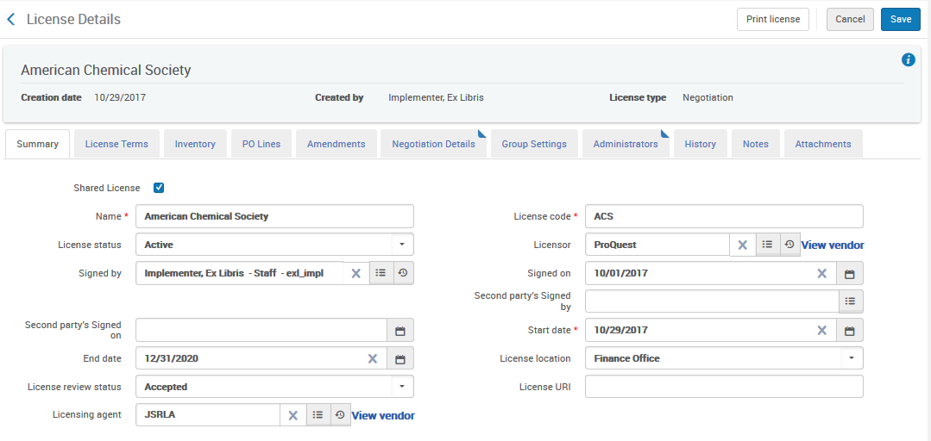
Distributing the negotiated license
If the license in the network zone and is designated as “Shared License” …

Slide 28
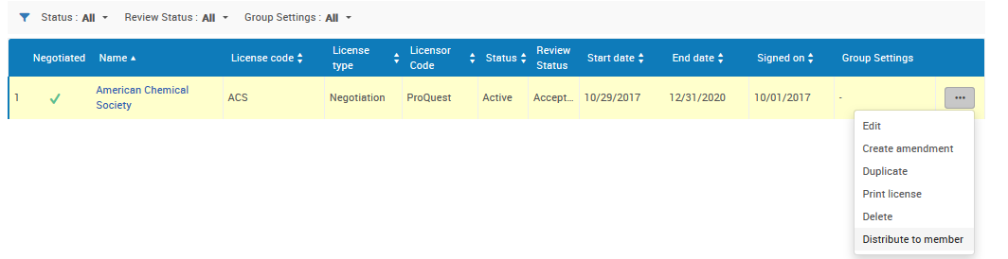
Distributing the negotiated license
Then the ‘Negotiated’ column is checked and the license can be distributed to the members

Slide 29
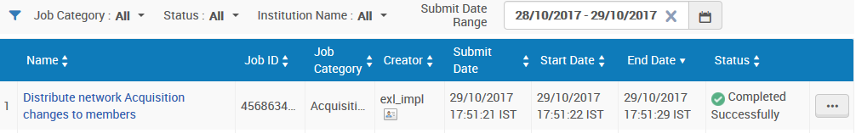
Distributing the negotiated license
The license will be distributed either by clicking “Distribute to member” or via the scheduled job ‘Distribute network Acquisition changes to members’.
Let’s see what happens when we distribute a negotiated license.
The job ‘Distribute network Acquisition changes to members’ has completed.

Slide 30
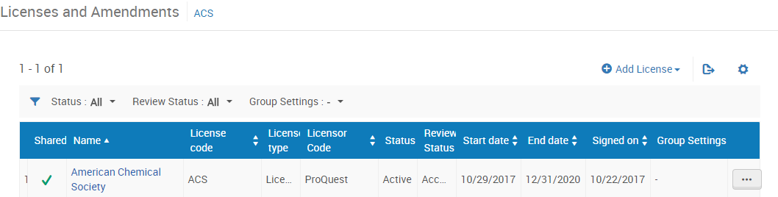
Distributing the negotiated license
Here is the distributed license in the member institution.
It is clear that the license is shared

Slide 31
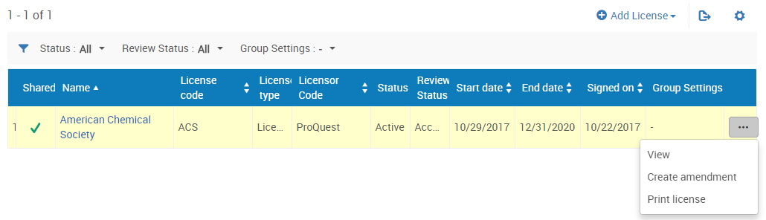
Distributing the negotiated license
The shared license cannot be edited, it can only be viewed.
It is possible however to create an amendment to the license.

Slide 32
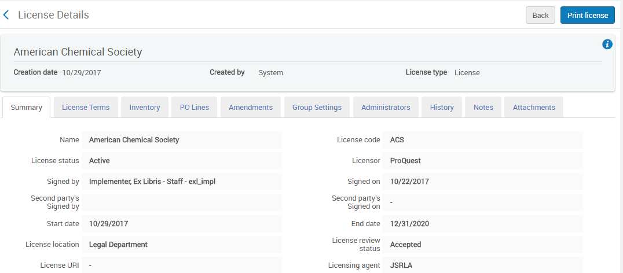
Distributing the negotiated license
The information in the ‘Summary’ and ‘License Terms’ tabs are shared with the member

Slide 33
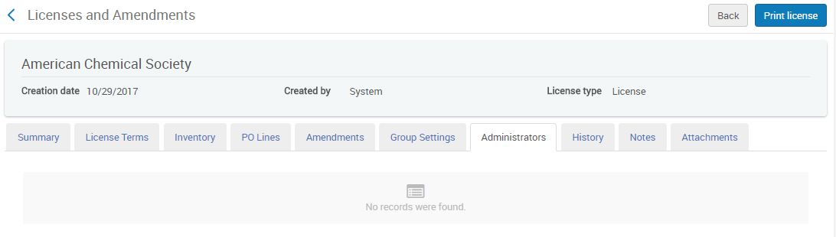
Distributing the negotiated license
The ‘Administrators’ are not shared with the member.
There is no ‘Negotiation Details’ tab in the member institution

Slide 34
Multiple contacts per member and adding administrators
Navigate from License to Licensor and Licensing agent
Distributing the negotiated license
Creating an amendment to the shared license
Linking member institution resource to network license or amendment
License Negotiation when content differs between members
License multi year negotiation - price per year

Slide 35
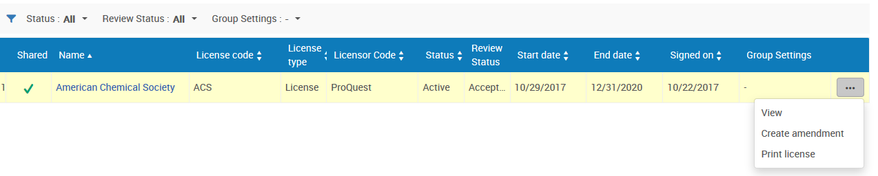
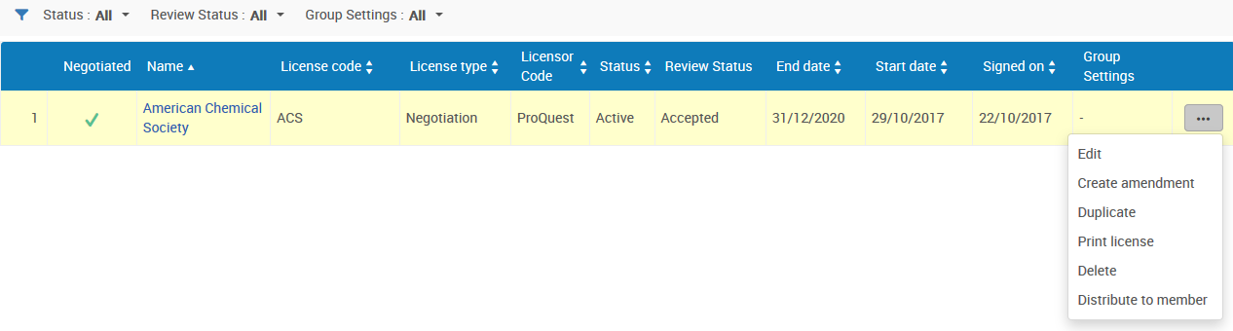
Creating an amendment to the shared license
After the distribution we have this in the institution
In member institution with limited options
We still have this in the network
In the network with full action options
URM-62449

Slide 36
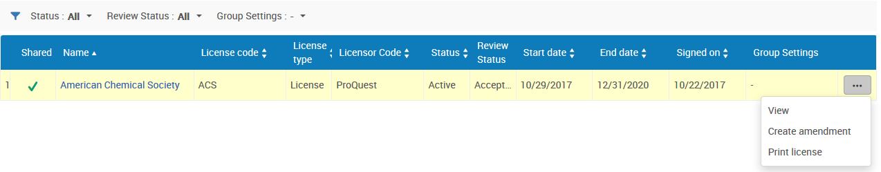
Creating an amendment to the shared license
In the member institution we cannot edit the shared license, but we can create an amendment to it.
The amendment can reflect anything “local” to the specific institution.
If an amendment is created then it in essence modifies the properties of the base license. Amendments added to a license override the base license.

Slide 37
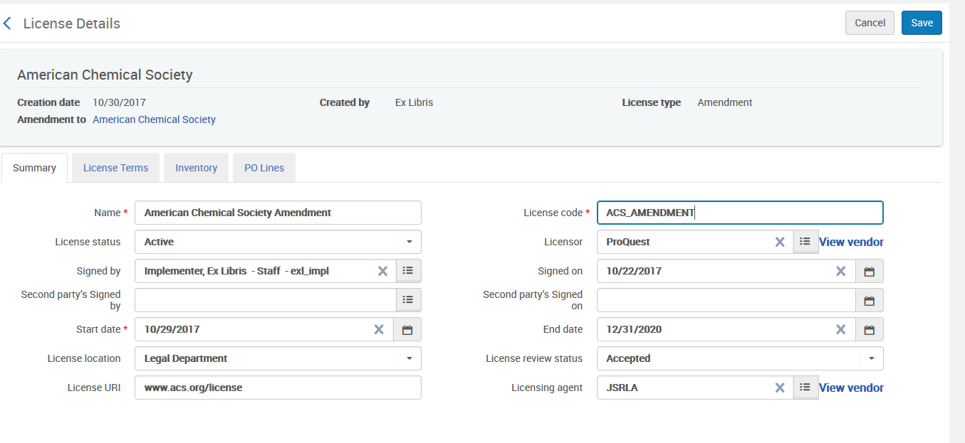
Creating an amendment to the shared license
A unique name and code have been given to the amendment.

Slide 38
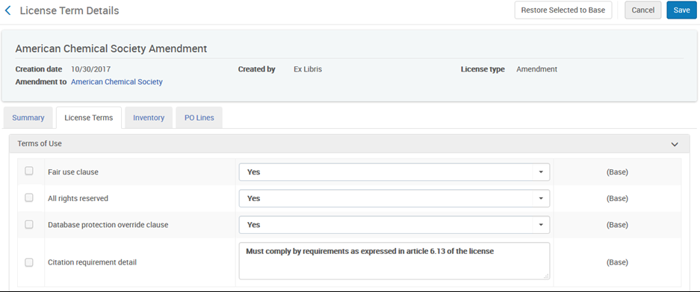
Creating an amendment to the shared license
Modify the license terms as desired

Slide 39
Creating an amendment to the shared license
After saving and viewing the license terms of the amendment you can see
Which license terms are from the “base” (license from the network)
Which license terms are specific to the amendment (to the institution).
License terms which are ‘base’ are automatically updated from the base license.

Slide 40
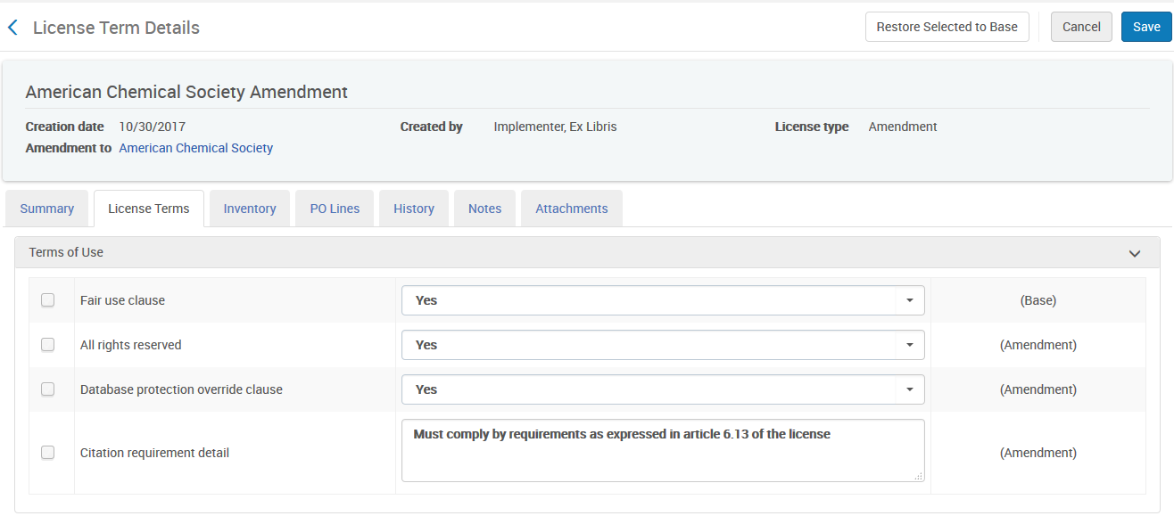
Creating an amendment to the shared license
It is also possible to select a term and restore it to the base
Part of the base licenses (from the network)
Unique to the amendment

Slide 41
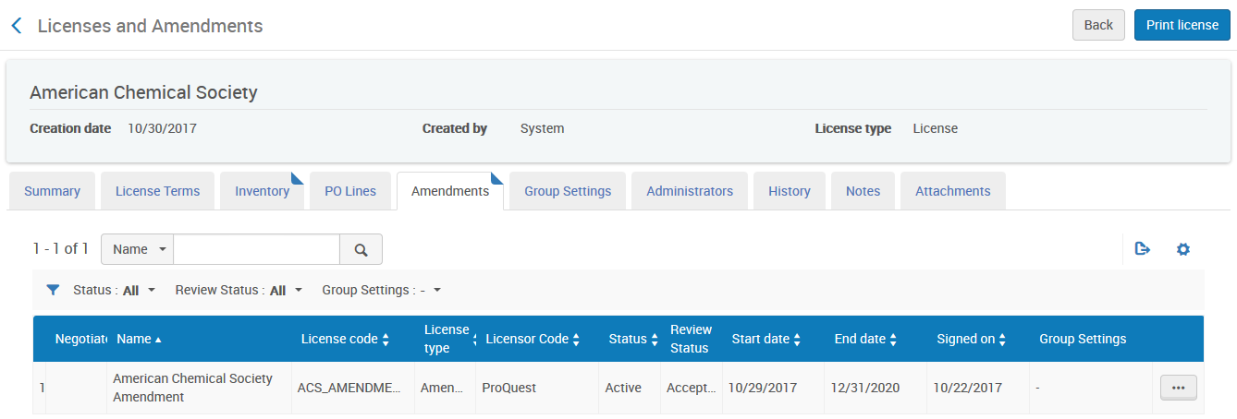
Creating an amendment to the shared license
The amendment of course appears in the ‘Amendments’ tab of the base license.

Slide 42
Multiple contacts per member and adding administrators
Navigate from License to Licensor and Licensing agent
Distributing the negotiated license
Creating an amendment to the shared license
Linking member institution resource to network license or amendment
License Negotiation when content differs between members
License multi year negotiation - price per year

Slide 43
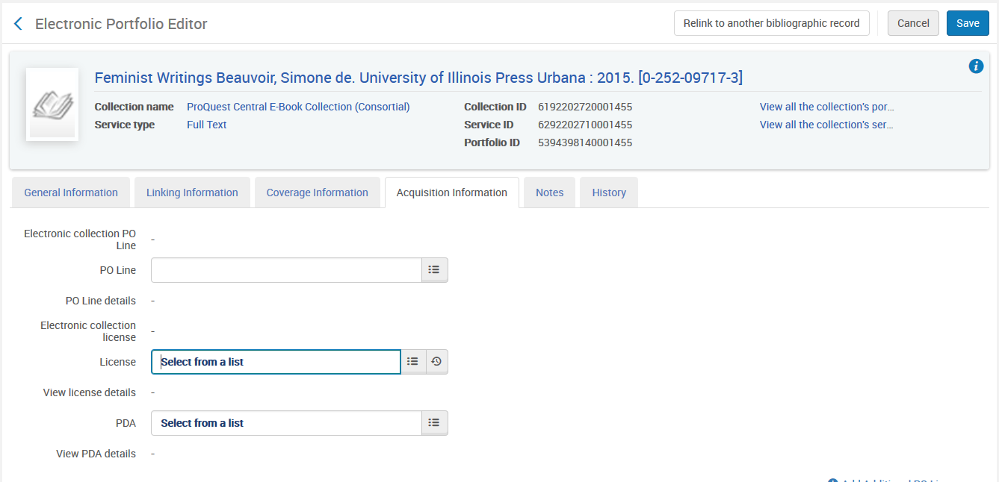
Linking member institution resource to network license or amendment
The network license in the member institution can be used for electronic inventory in the member institution.
From within the portfolio we will choose the license

Slide 44
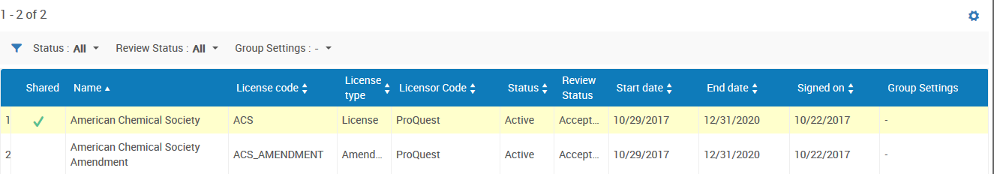
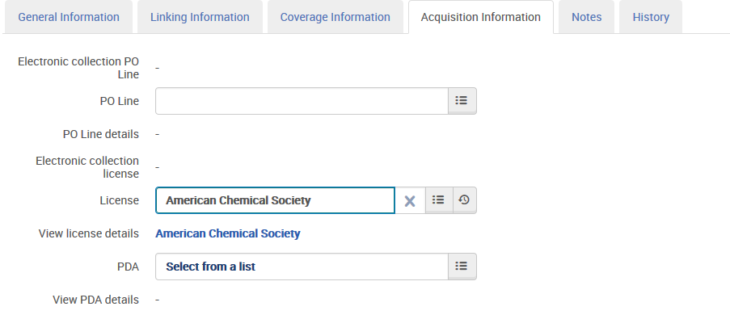
Linking member institution resource to network license or amendment
And we will choose the shared license

Slide 45
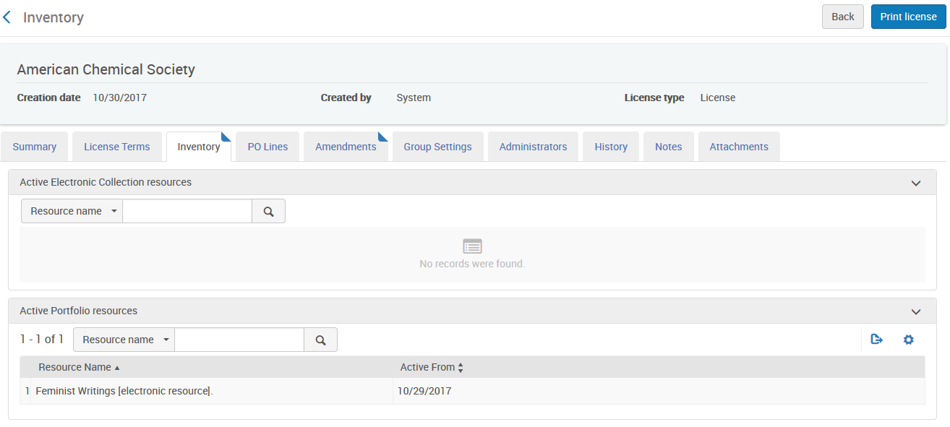
Linking member institution resource to network license or amendment
The resource now appears in the inventory tab of the shared license.

Slide 46
Linking member institution resource to network license or amendment
But … if we want to use the unique license terms which we established in the amendment then we should link the electronic resource of the member institution to the amendment.
This way when the end user views the resource and from the ViewIt tab he views license details he will see the unique license terms which are part of the amendment.

Slide 47
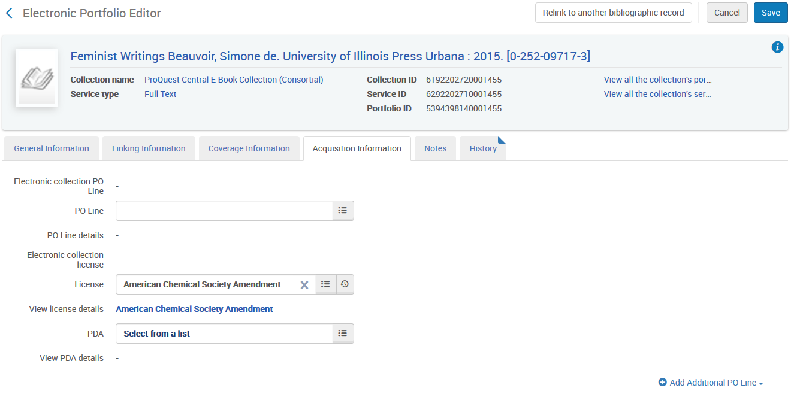
Linking member institution resource to network license or amendment
Now instead of linking the electronic resource in the member institution to the license in the network we will link it to the amendment of the license in the network

Slide 48
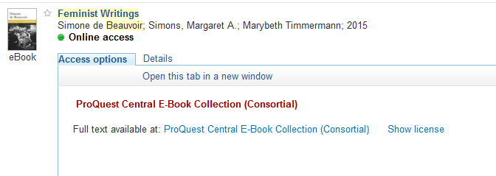
Linking member institution resource to network license or amendment
Here is the link to the license from the Primo View It

Slide 49
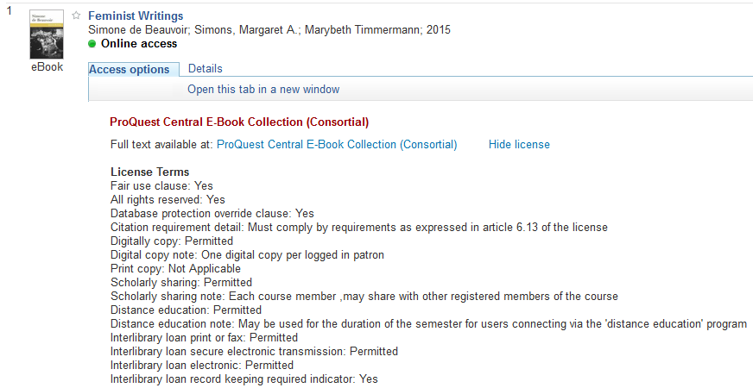
Linking member institution resource to network license or amendment
The license terms appear. These are coming from the license amendment which is taking some terms from the base license and some terms from what has been added only to the amendment.

Slide 50
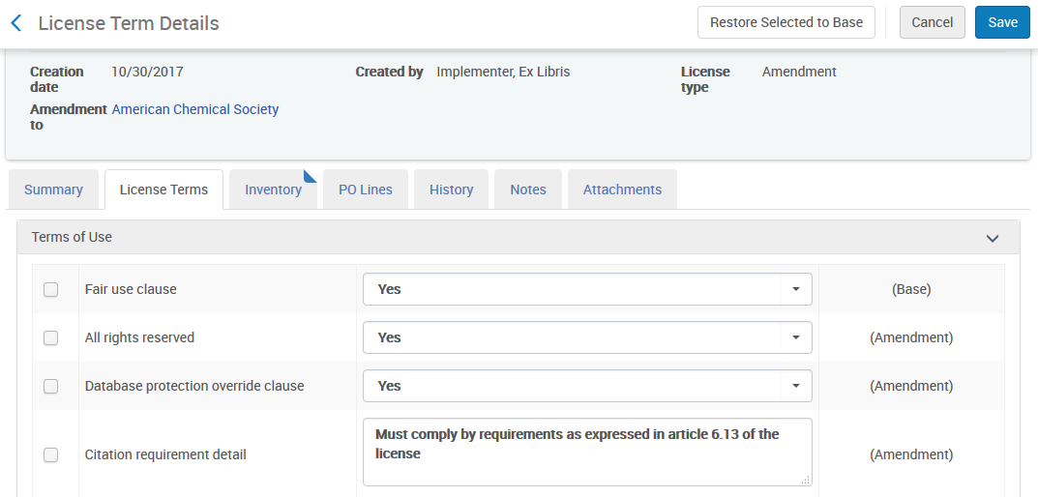
Linking member institution resource to network license or amendment
These are license terms which appeared to the end user because these are the license terms of the amendment in which was attributed to the electronic resource

Slide 51
Linking member institution resource to network license or amendment
For example

Slide 52
Multiple contacts per member and adding administrators
Navigate from License to Licensor and Licensing agent
Distributing the negotiated license
Creating an amendment to the shared license
Linking member institution resource to network license or amendment
License Negotiation when content differs between members
License multi year negotiation - price per year

Slide 53
License Negotiation when content differs between members
This feature deals with Acquisition Networks that manage licenses of type Negotiation
With this feature it is possible to have a situation in which the content negotiated for each member is not always the same.
Each member may have different content for the same license.
Even when the content is the same for different members, it may have a different price, start date and end date.
URM-60366

Slide 54
License Negotiation when content differs between members
In other words: it is possible to manage a “complex deal” in which the content of the license is different for each member
The central / head office negotiates a deal with a vendor and can then use a license of type ‘negotiation’ to indicate for each member the relevant content that was negotiated for each member.
In this way the central / head office does not have to maintain a separate license for each institution.
URM-60366

Slide 55
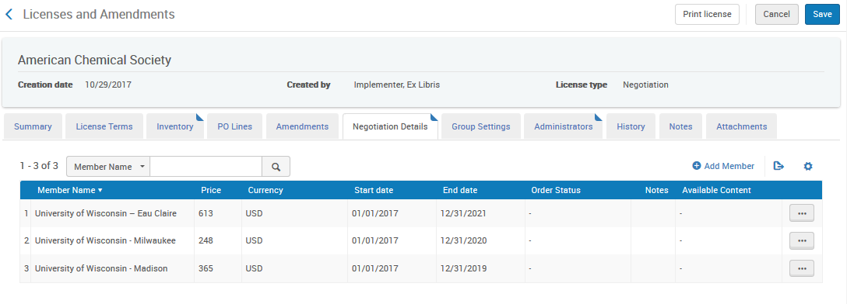
License Negotiation when content differs between members
Negotiation License:
Price and other details per member. Here the price and end date differs per member

Slide 56
License Negotiation when content differs between members
For example:
In the network institution the following four electronic resources all have license ‘American Chemical Society’
Chemical ecology / edited by Anne-Geneviève Bagnères, Martine Hossaert-Mckey.
Chemical reactions / Films for the Humanities & Sciences (Firm)
Chemical week [electronic resource].
Chemical equilibria / Michel Soustelle.

Slide 57
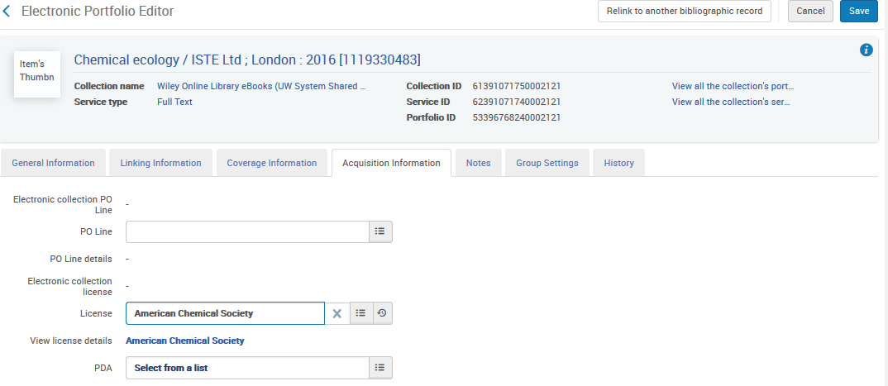
License Negotiation when content differs between members
In the network institution the resource ‘Chemical Ecology’ has license ‘American Chemical Society’

Slide 58
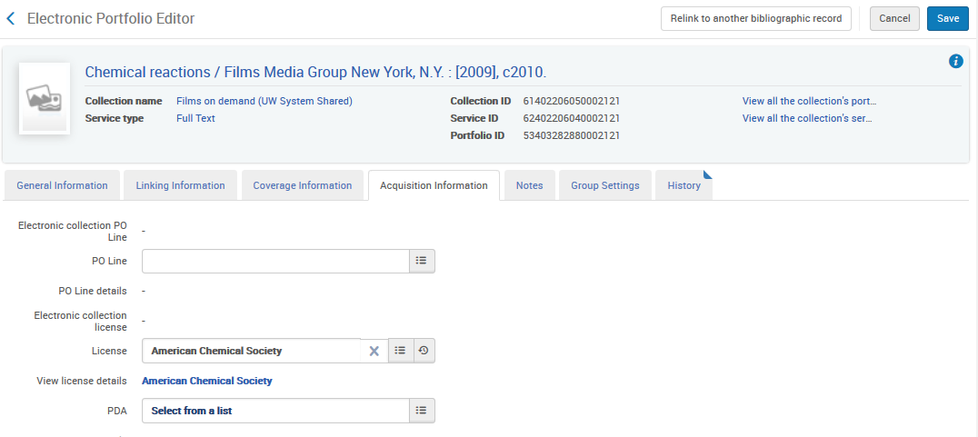
License Negotiation when content differs between members
In the network institution the resource ‘Chemical reactions’ has license ‘American Chemical Society’

Slide 59
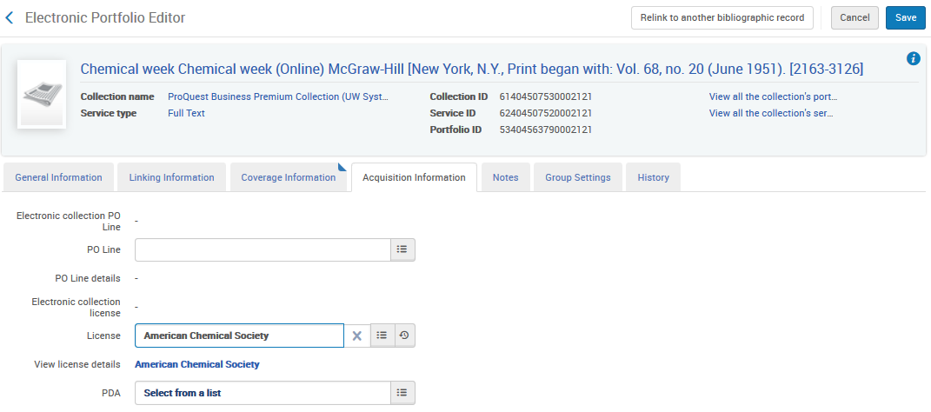
License Negotiation when content differs between members
In the network institution the resource ‘Chemical week’ has license ‘American Chemical Society’

Slide 60
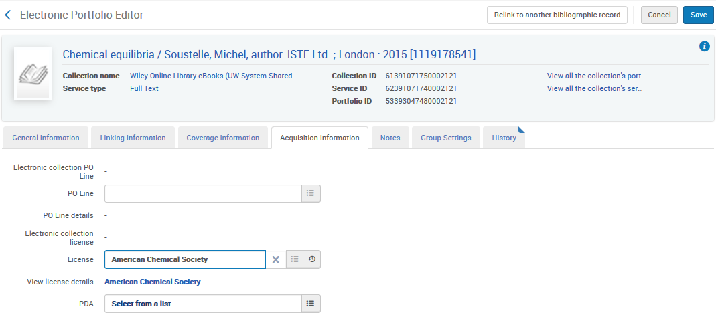
License Negotiation when content differs between members
In the network institution the resource ‘Chemical equilibria’ has license ‘American Chemical Society’

Slide 61
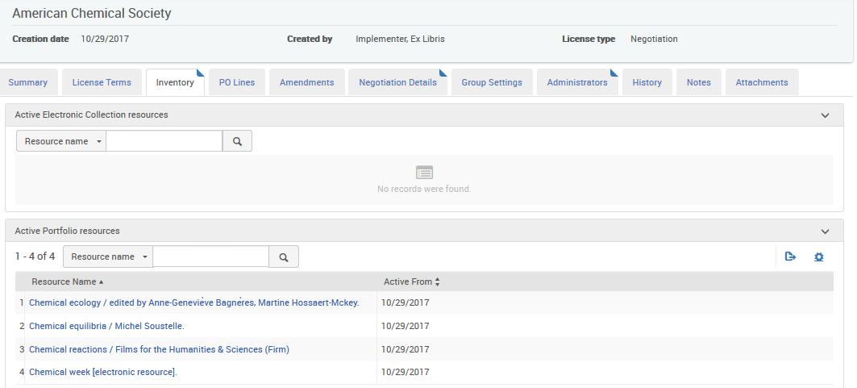
License Negotiation when content differs between members
In the inventory tab of the license all four resources appear:

Slide 62
License Negotiation when content differs between members
But … not every member of the license might have access via the license to all four resources.
Further, even if multiple members do have access to the same resource it might be under differing terms.

Slide 63
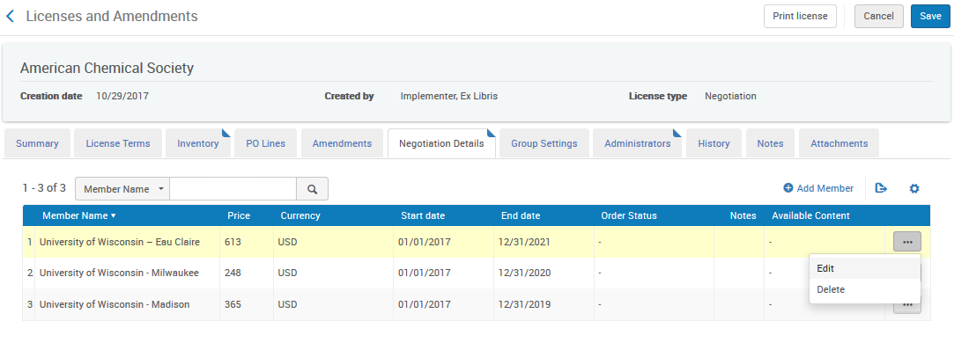
License Negotiation when content differs between members
It is therefore possible to edit each member and then attribute only the relevant resources (inventory)

Slide 64
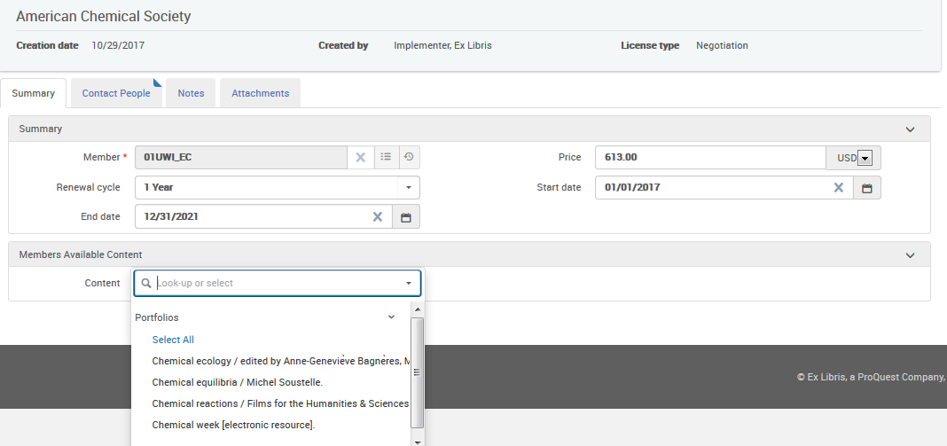
License Negotiation when content differs between members
Now for this specific member I can choose which content is relevant for him:

Slide 65
License Negotiation when content differs between members
The actual license might be as follows
Institution Eau Claire pays 613.00 USD for a period of 01/01/2017 to 12/31/2021 for resources “Chemical equilibria”, “Chemical ecology” and “Chemical week”
Institution Milwaukee pays 248.00 USD for a period of 01/01/2017 to 12/31/2020 for resources "Chemical ecology", "Chemical reactions" and "Chemical week“
Institution Madison pays 365.00 USD for a period of 01/01/2017 to 12/31/2019 for resources "Chemical equilibria", "Chemical ecology" and "Chemical reactions"

Slide 66
License Negotiation when content differs between members
The license looks like this
 | Eau Claire | Milwaukee | Madison
Chemical Ecology | X | X | X
Chemical Equilibria | X |  | X
Chemical Week | X | X
Chemical Reactions |  | X | X
 | Start | End | Price
Eau Claire | 01/02/2017 | 12/31/2021 | 613.00 USD
Milwaukee | 01/02/2017 | 12/31/2020 | 248.00 USD
Madison | 01/02/2017 | 12/31/2019 | 365.00 USD

Slide 67
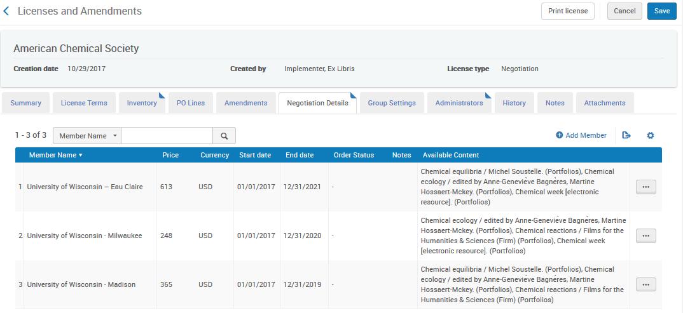
License Negotiation when content differs between members
The negotiation details tab looks like this

Slide 68
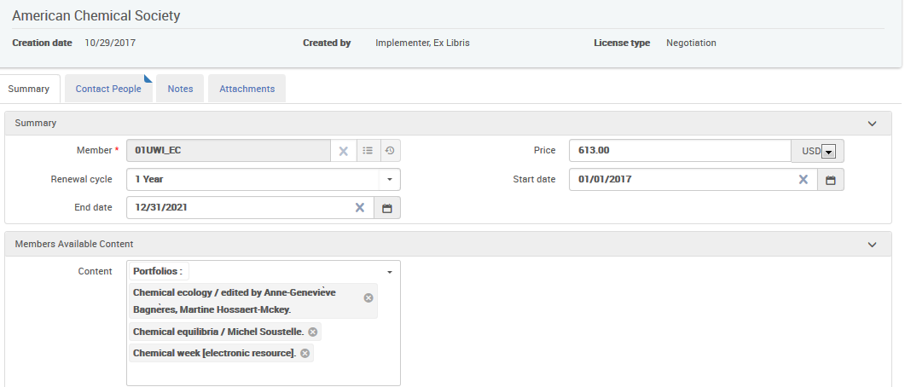
License Negotiation when content differs between members
This for example is the current ‘Eau Claire’ member in edit mode

Slide 69

License Negotiation when content differs between members
This for example is the current ‘Milwaukee’ member in edit mode

Slide 70

License Negotiation when content differs between members
This for example is the current ‘Madison’ member in edit mode

Slide 71
Multiple contacts per member and adding administrators
Navigate from License to Licensor and Licensing agent
Distributing the negotiated license
Creating an amendment to the shared license
Linking member institution resource to network license or amendment
License Negotiation when content differs between members
License multi year negotiation - price per year

Slide 72
License multi year negotiation - price per year
When license is
  Added in the network zone and
  Is of type negotiation and
  The start date and end date range is more than one year
Then
  In the negotiation details tab the staff user can fill in price details per member including the percent increase per year.
  In this manner when the POL is renewed it will automatically get the price increase by percent from the member details.

Slide 73

License multi year negotiation - price per year
Here for example license “International Chemical Society” is in the network zone, it is of type negotiation and the start date and end date range is more than one year

Slide 74

License multi year negotiation - price per year
The license “International Chemical Society” is used by resource “CBIAC newsletter Chemical Warfare”

Slide 75
License multi year negotiation - price per year
Now we
Add a member in the negotiation details tab of this license
Include resource “CBIAC newsletter Chemical Warfare”
Give a price of 100
Give a percent increase of 10

Slide 76

License multi year negotiation - price per year

Slide 77

License multi year negotiation - price per year
Now from the member we search for this portfolio in the network tab and click “order”

Slide 78

License multi year negotiation - price per year
Create the order

Slide 79

License multi year negotiation - price per year
The license is automatically there in the POL which is created in the member institution (taken from license of resource using information from member)

Slide 80

License multi year negotiation - price per year
The price is automatically there in the POL which is created in the member institution (taken from license of resource using information from member)

Slide 81

License multi year negotiation - price per year
For our demonstrative purposes we will set up the renewal section of the POL as follows:
Manual renewal
Subscription from date: 01/01/2017
Subscription to date: blank
Renewal date: today

Slide 82

License multi year negotiation - price per year
The POL is sent and waiting for renewal

Slide 83


License multi year negotiation - price per year
We will make the renewal date one year from previous renewal date. Previous renewal date was 11/14/2017. New renewal date 11/15/2018
And then click renew

Slide 84

License multi year negotiation - price per year
Get confirmation message

Slide 85

License multi year negotiation - price per year
Now we see that it was increased by 10% from 100 to 110.00

Slide 86
Thank You
https://www.wien.info/en/sightseeing/architecture-design/wu-campus

